Slide 1
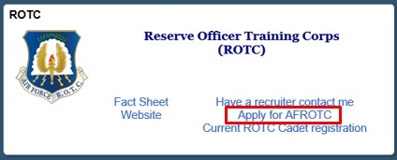
Step 0:
Overview
WINGS Module: Applicant Admissions Process
This guide provides detailed instructions for prospective students applying to the Air Force ROTC program through the WINGS Portal. The admissions process involves applying, being checked for viability, and officially registering as cadets.
Purpose: This guide is designed to assist applicants in completing the admissions process required to in-process a Cadet into Air Force ROTC.
Step 1:
Applying for AFROTC
Access the Holm Center WINGS Portal
Navigate to the Holm Center WINGS Portal: https://wings.holmcenter.com.
Click on the "Apply for ROTC" link on the homepage.
  Screenshot below: Click "Apply for AFROTC"
Agree to the Privacy Act Statement
You will be directed to the Privacy Act Statement.

Slide 2
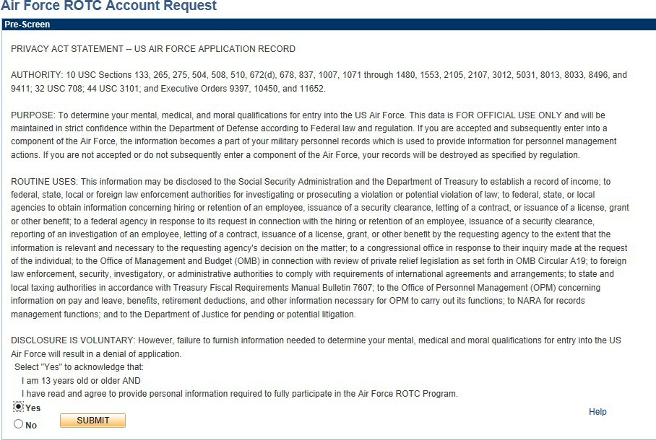
If you agree with the statement, click "Yes" and "Submit."
Create Your Account
Enter your Last Name, First Name, and
Middle Initial
(if applicable).
Enter your UA email address (If you have one)in the E-Mail field. This will serve as your username. The
email address should be one that you check regularly.
Confirm your email by re-entering it in the field.
Confirm E-Mail
Create a secure that meets the following requirements:
password
Minimum length of 12 characters
At least 2 special characters
At least 2 numbers
At least 1 uppercase letter
At least 1 lowercase letter
Re-enter your password in the field.
Confirm Password
Select a and provide a response that will be used for password recovery.
security question
Click Submit to proceed. Refer to the screenshot below.

Slide 3
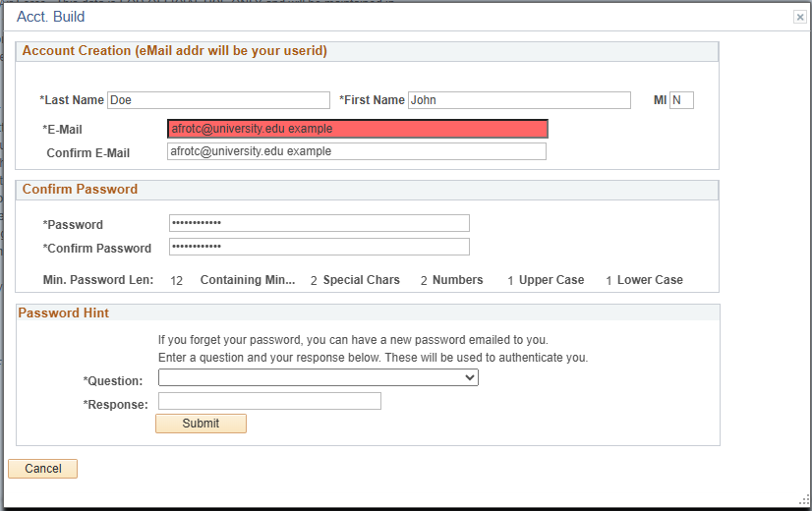
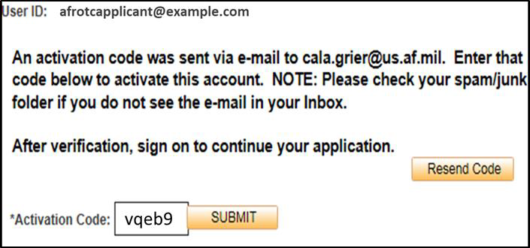
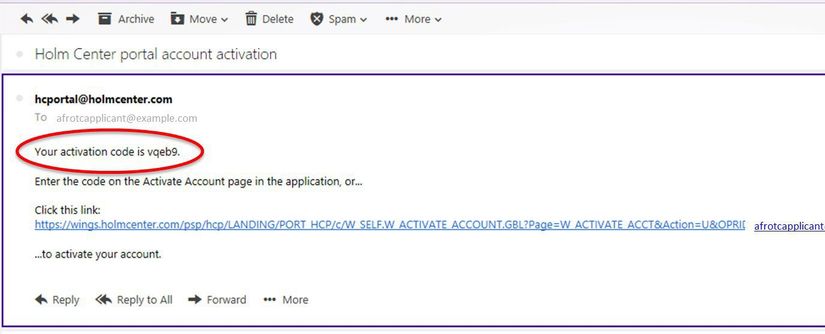
You will be directed to a new screen, notifying you that an activation code was sent to your email address. Keep the window open and check your email for the activation code. Refer to the screenshots below.

Slide 4
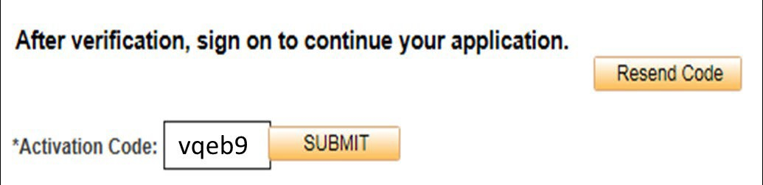

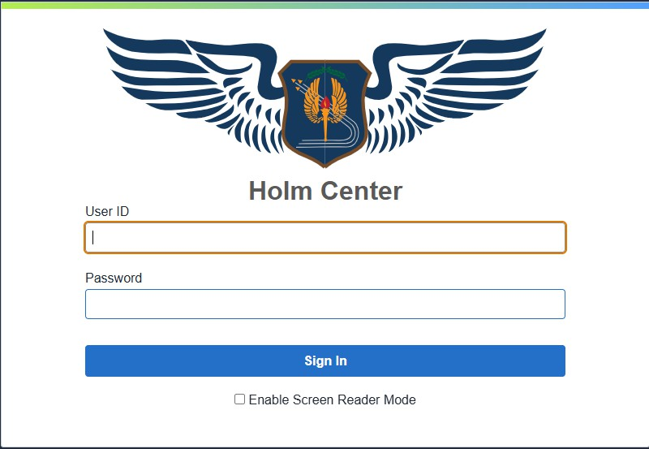
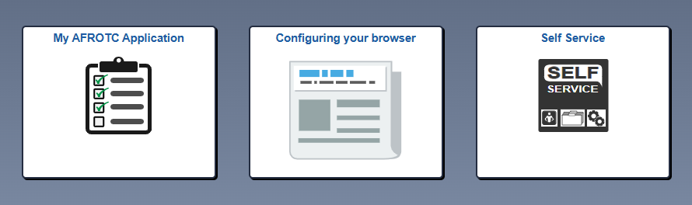
Sign in to WINGS
Use your email address and password to log in to the WINGS Portal.
After logging in, click on the "My ROTC Application" tile to proceed.

Slide 5
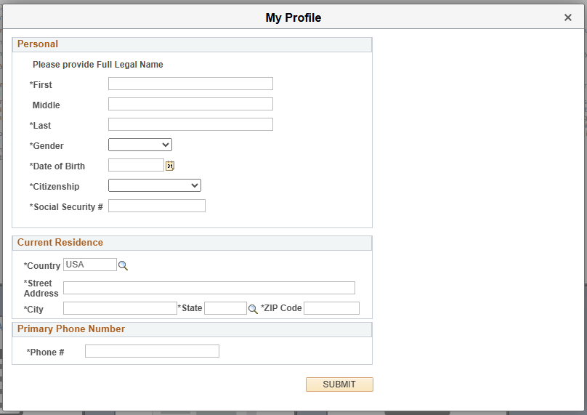
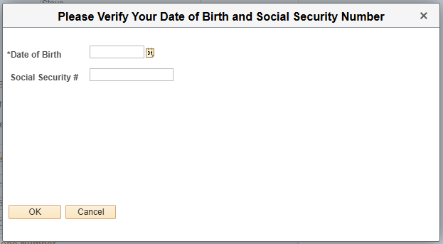
Complete your profile by filling in all required fields and verifying your Date of Birth and Social Security Number.
Verify your Date of Birth and Social Security Number.
Your Account Profile will be stored in the WINGS database and will direct you to your application.
Note: If there is an existing profile with similar data as yours, your profile will be reviewed by HQ AFROTC, and you will receive a notification that your account profile is under review.

Slide 6
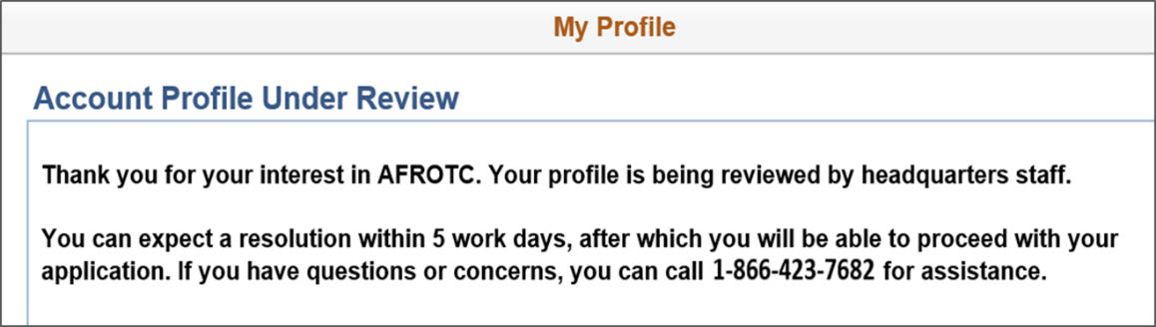
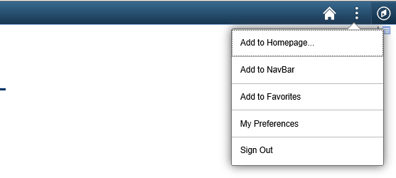
Sign out of WINGS by clicking the three dots located at the top right corner of the screen.
Sign out of WINGS by clicking the three dots located at the top right corner of the screen.
Step 2:
Completing the Application Checklist (overview)
Login to WINGS
Navigate to the Holm Center WINGS Portal: https://wings.holmcenter.com.
Login using the email address and password you created during the account setup.

Slide 7
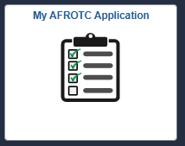
Access the AFROTC Application
After logging in, click on the "My ROTC Application" tile.
  Screenshot below: Click "My ROTC Application"
Intent to Complete the Application
Join AFROTC: Indicate your intent to join AFROTC by selecting "Yes" or "No" at the top of the checklist.
My Application To-Do List
Complete each section listed in the My Application To-Do List. A check mark will appear in the box once the section is complete:
Select Schools
  Choose the correct college. For AFROTC Det 010 you will see the Correct one is listed under University of Alabama. (Note: If you are a Cadet from MMI, be sure to select that option.)

Slide 8
Youth
Answer questions about any youth experience, and upload any relevant certificates or documents.
Contact Information
Provide accurate details for your phone number, email address, and home address. Add an emergency contact if applicable.
Demographics
Complete the required fields under demographics.
Military Information
If applicable, provide your Selective Service Number (for males 18 and older).
Medical Information
Answer all fields regarding your medical history.
Dependents
If you have dependents, fill in the necessary fields and acknowledge the statements regarding dependent care.
Questions/Acknowledgements
Read and answer all the questions and acknowledgements truthfully.
Releases & Forms
Skip this portion you will be sent all forms that are needed to fill out.
Supporting Documents
Upload any necessary files, depending on your application responses (e.g., Scout Certificates for Boy Scouts).
Civil Involvements
Report any involvement with civil, military, or school authorities/law enforcement, regardless of its significance. Provide details and upload relevant documents if required.

Slide 9
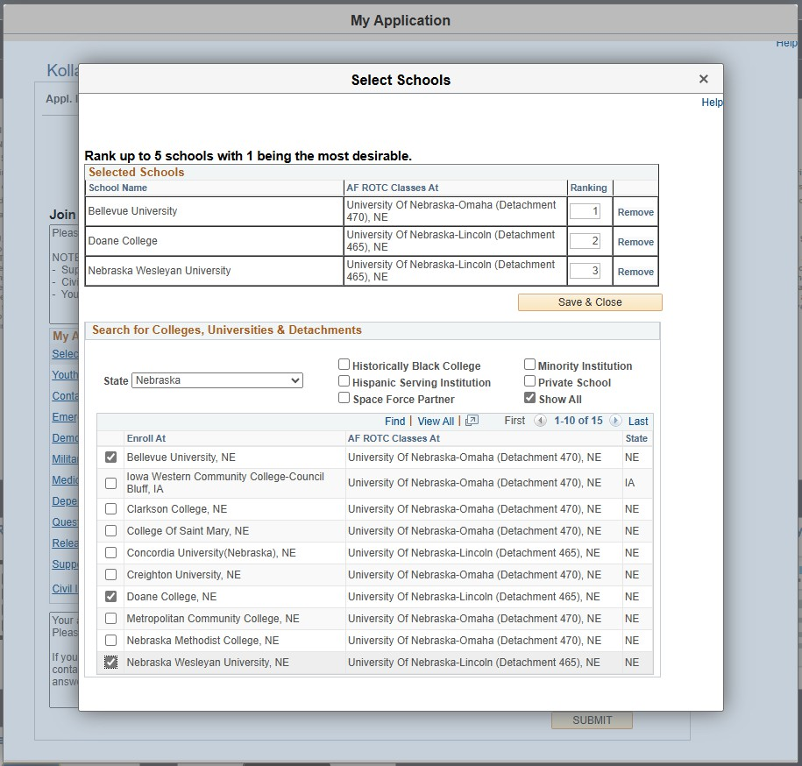
Step 3:
Select Schools
Access the "Select Schools" Section
After logging into WINGS and reaching the My ROTC Application tile, navigate to the Select Schools section in your application checklist.
Choose Your Preferred Colleges
Use the dropdown menus to select the State where your preferred colleges are located.
After selecting the state, choose the specific College from the list provided.
Rank Your School Preferences
If you have more than one college preference, rank them in order of priority.
Use the provided options to rearrange the order of your selected schools if necessary.
Save Your Selections
Once you’ve selected and ranked your colleges, click Save & Close to save your selections.
A checkmark will appear next to Select Schools in your application checklist, indicating that this section is complete.

Slide 10
Step 4:
Youth Experience
Access the "Youth Experience" Section
In the My ROTC Application checklist, click on Youth Experience to begin this section.
Indicate JROTC Experience
You will be prompted to answer whether you have any Junior Reserve Officers' Training Corps (JROTC) experience.
Select Yes or No depending on your experience.
Provide Other Youth Experience
For each of the following categories, select the most applicable option from the dropdown menus:
  Scout Experience: Indicate if you have any experience with organizations like Boy Scouts, Girl Scouts, etc.
  CAP (Civil Air Patrol): Indicate if you have any involvement with the Civil Air Patrol.
  Prior Officer Training: Indicate if you have participated in any prior officer training programs.
If none of these apply to you, select Not Applicable or None from the dropdown menus.
Save and Close
After providing your information, click Save & Close to complete this section.
A checkmark will appear next to Youth Experience in your application checklist, indicating that this section is complete.

Slide 11
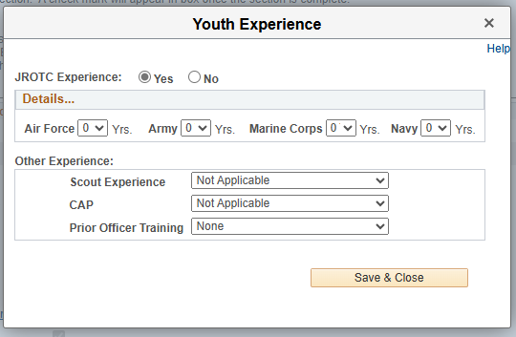
Step 5:
Contact Information
Access the "Contact Information" Section
In the My ROTC Application checklist, click on Contact Information to begin this section.
Enter Your Phone Number(s)
Add your Primary Phone Number in the designated field.
Select the Type of phone number (e.g., Cell, Home, Work) from the dropdown menu.
If you want to opt-in for text messaging, ensure the Type is set to "Cell" and check the box labeled Text Approval.
Enter Your Email Address
Confirm that your Primary Email Address is correct in the email field.
Select the appropriate Type (e.g., Personal, School, Work) from the dropdown menu.
Provide Your Addresses
Home of Record (HOR) Address: Enter your Home of Record (HOR) address. This is a required field. The Home of Record is usually your permanent residence

Slide 12
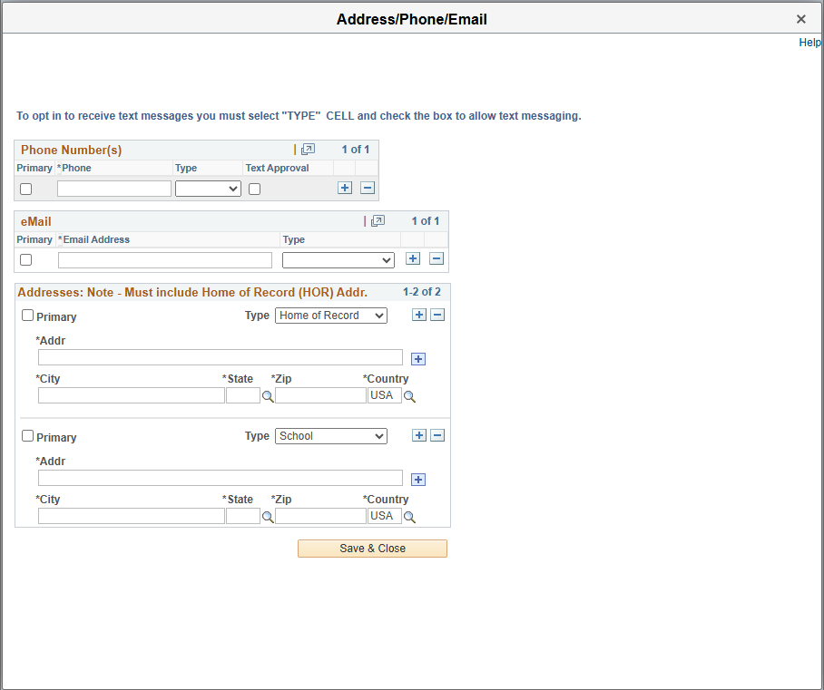
or your parents' home, where you legally reside and would return after completing your education or if you were to leave the program. It must include details such as Street, City, State, Zip, and Country.
College/School Address: While it is not required, it is highly encouraged to also provide the address where you will stay while attending college. This helps ensure accurate communication and delivery of any important documents during your time at school.
If applicable, click the + sign to add your college/school address, and label it correctly as School.
Save and Close
After entering your contact information, click Save & Close to complete this section.
A checkmark will appear next to Contact Information in your application checklist, indicating that this section is complete.
Step 6:
Emergency Contacts
Access the "Emergency Contacts" Section

Slide 13
Step 6:
Emergency Contacts
Access the "Emergency Contacts" Section
In the My ROTC Application checklist, click on Emergency Contacts to begin this section.
Enter Your Primary Emergency Contact
Relationship: Select the relationship of your primary emergency contact (e.g., Father, Mother, Spouse) from the dropdown menu.
Name: Enter the First Name and Last Name of your emergency contact.
Address: Provide the complete address, including Street, City, State, Zip, and
Country. This is a required field.
Phone Number: Enter the primary phone number for your emergency contact. Select the Type of phone number (e.g., Cell, Home, Work) from the dropdown menu.
Email Address (optional): If available, enter the email address for your emergency contact. This is optional but recommended for additional communication.
Enter a Secondary Emergency Contact (Highly Preferred)
While only one emergency contact is required, it is highly preferred to provide a secondary contact.
Relationship: Select the relationship of your secondary emergency contact.
Name: Enter the First Name and Last Name.
Address: Provide the address, following the same format as the primary contact.
Phone Number: Enter the phone number and select the Type.
Email Address (optional): If available, include an email address for the secondary contact.
Update & Verify
Once you have entered all required and optional information, click Update & Verify to save your emergency contact details.
A checkmark will appear next to Emergency Contacts in your application checklist, indicating that this section is complete.

Slide 14
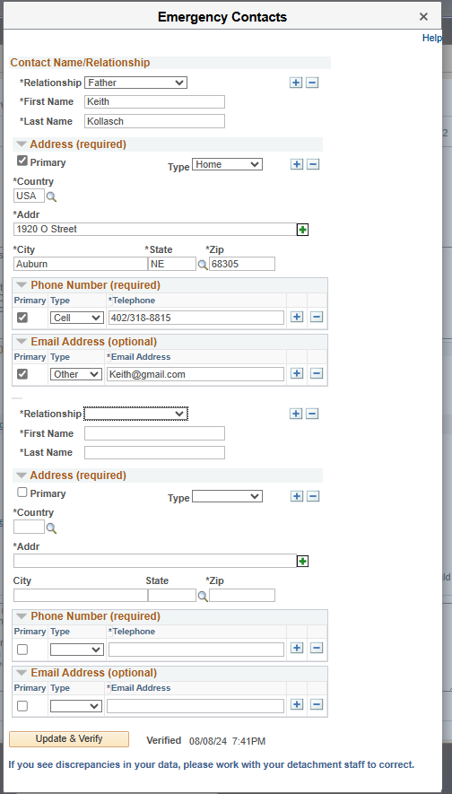
Step 7:
Demographics
Access the "Demographics" Section
In the My ROTC Application checklist, click on Demographics to begin this section.
Enter Your Birth Information
Date of Birth: Use the calendar tool to select your date of birth.
Gender: Choose your gender from the dropdown menu.
Birth Country: Select your birth country from the dropdown.

Slide 15
Birth State: If applicable, select your birth state.
Birth City: Enter the city where you were born.
Citizenship
Citizenship: Select your citizenship status (e.g., Birth - US).
Social Security Number (SSN): Enter your SSN in the provided field.
Dual Citizenship: Indicate whether you hold dual citizenship by selecting Yes or
No.
Race
Select the race category that best describes you. You can choose multiple options if applicable.
If you prefer not to disclose this information, select Decline to Respond. Ethnicity
Choose your ethnicity by selecting one of the following options:
  Hispanic/Latino
  Not Hispanic/Latino
  Decline to Respond Save and Close
After entering all required demographic information, click Save & Close to complete this section.
A checkmark will appear next to Demographics in your application checklist, indicating that this section is complete.

Slide 16
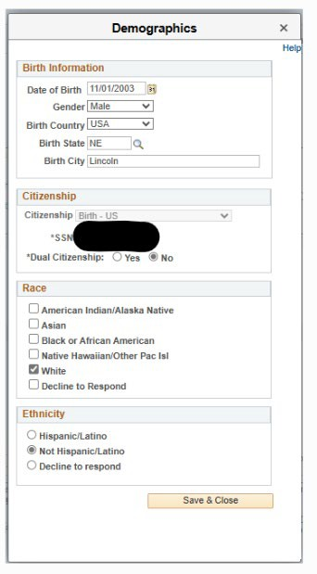
Step 8:
Military Information
Access the "Military Information" Section
In the My ROTC Application checklist, click on Military Information to begin this section.

Slide 17
Indicate Military Service
Select Yes or No to indicate whether you have prior military service.
AFOQT (Air Force Officer Qualifying Test)
Indicate whether you have taken the AFOQT by selecting Yes or No.
The AFOQT is a standardized test that measures verbal and math aptitude, along with other skills relevant to specific career fields within the Air Force. It is typically taken during your sophomore year in the AFROTC program.
Provide Your Selective Service Number
Who Needs to Register: Males aged 18 and older are required by U.S. law to register for Selective Service and must provide their Selective Service Number. Females are not required to register and can skip this section.
Under 18: If you are under 18, you do not need a Selective Service Number at this time. However, you must register for Selective Service upon turning 18 and then update your application with your Selective Service Number.
Finding Your Selective Service Number: If you have already registered but do not know your number, you can look it up online at the Selective Service System website.
Lookup Tool: Use the "Lookup" link in the application if you need assistance in finding your Selective Service Number.
Important Notes:
For applicants under 18, not having a Selective Service Number will not affect scholarship eligibility or processing.
Once you turn 18, ensure that you register for Selective Service and update your application accordingly. If access to the checklist is no longer available, your detachment staff can assist.
Save and Close
After entering your military background information, click Save & Close to complete this section.
A checkmark will appear next to Military Information in your application checklist, indicating that this section is complete.

Slide 18
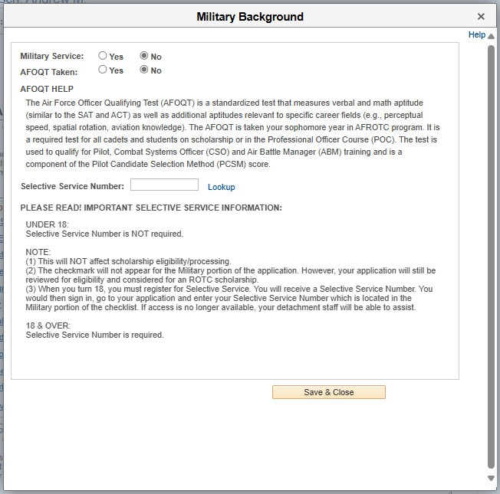
Step 9:
Questions/Acknowledgements
Access the "Questions/Acknowledgements" Section
In the My ROTC Application checklist, click on Questions/Acknowledgements
to begin this section.
Participatory Physical
You will be asked whether you have ever had a physical for entry into the U.S. Armed Forces, Air Force ROTC, or similar programs.
Answer "Yes" or "No" based on your experience.
If you select "Yes", you will be prompted to provide additional information, including the type and date of the physical.
  Example: Enter details such as "25 Dec 1999, MEPS" if you had a Military Entrance Processing Station (MEPS) physical.
  Note: You may be asked to provide a copy of this physical as part of your application.

Slide 19
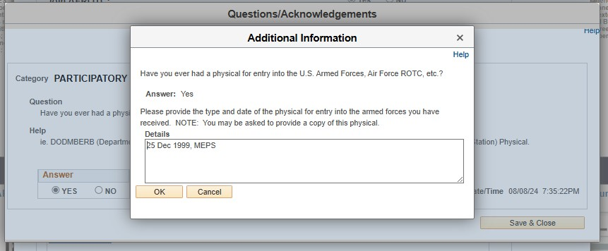
Complete Additional Questions
Continue to answer any further questions that appear in this section. These may include acknowledgements of various AFROTC requirements, consent for participation, and understanding of program obligations.
Ensure all questions are answered truthfully and to the best of your knowledge.
Save and Close
After completing all the questions and acknowledgements, click Save & Close to complete this section.
A checkmark will appear next to Questions/Acknowledgements in your application checklist, indicating that this section is complete.
Step 10:
Dependents
Access the "Dependents" Section
In the My ROTC Application checklist, click on Dependents to begin this section.

Slide 20
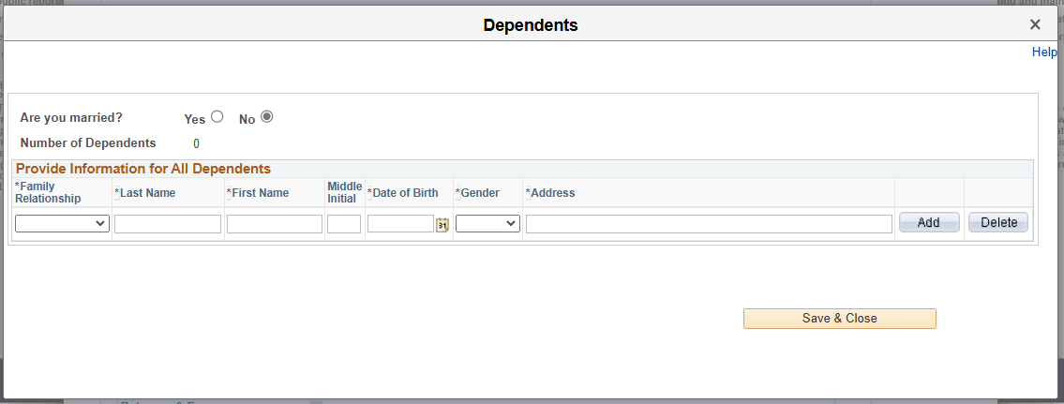
Marital Status
Are you married?: Indicate whether you are married by selecting Yes or No. Spouse Information
Is your spouse Military?: If you are married, indicate whether your spouse is in the military by selecting Yes or No.
If your spouse is not dependent on you, select the "ND Spouse" relationship option for Nondependent Spouse.
Provide Information for All Dependents
Number of Dependents: Enter the number of dependents you have.
For each dependent, provide the following information:
  Family Relationship: Select the relationship (e.g., Child, Spouse).
  Name: Enter the Last Name, First Name, and Middle Initial.
  Date of Birth: Provide the dependent's date of birth.
  Gender: Select the gender of the dependent.
  Address: Enter the dependent’s address if it differs from your own.
Use the Add button to include each dependent, and the Delete button if you need to remove an entry.
Dependent/Dependent Care Acknowledgements
You will be presented with several acknowledgments related to your dependents and your responsibilities regarding their care.

Slide 21
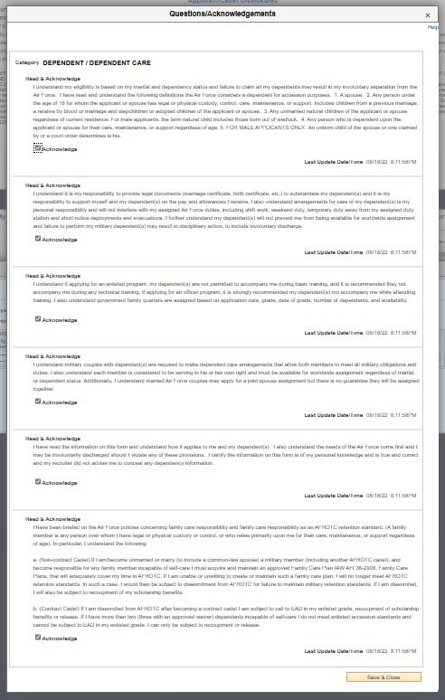
Important:
Even if you are not married and do not have dependents, you must click
the Next Step button and read & acknowledge every statement.
This step is often
missed but is essential for completing the application correctly.
Carefully read and acknowledge each statement by checking the box next to "I Acknowledge."
  These acknowledgments cover important topics such as your eligibility based on marital and dependency status, documentation requirements, and understanding of policies regarding dependents during your time in the AFROTC program.
Save and Close
After entering all required dependent information and acknowledging the statements, click Save & Close to complete this section.
A checkmark will appear next to Dependents in your application checklist, indicating that this section is complete.
Step 11:
Acknowledgments and Questions

Slide 22
Step 11:
Acknowledgments and Questions
Access the "Critical Acknowledgments and Questions" Section
In the My ROTC Application checklist, click on Critical Acknowledgments and Questions to begin this section.
Read and Answer Each Question Carefully
This section includes multiple categories with questions and acknowledgments that are binding and critically important for your participation in AFROTC. These categories include, but are not limited to:
Categories to Complete:
Acceptance
Prior Service
Drug and Alcohol
Releases
Disciplinary / Criminal History
Prohibited Activities
Carefully read each question and any associated help text provided to understand what is being asked.
Answering the Questions
For each question, select Yes or No as appropriate.
Some questions may require additional details if you select Yes. Be prepared to provide any necessary explanations or documentation.
Example: If asked if you have ever been convicted of a felony, and you select
Yes, you may be required to provide further details about the conviction.
Read and Acknowledge Statements
Many sections require you to read and acknowledge statements related to your obligations, conduct, and expectations as a participant in the AFROTC program.
After reading each statement, check the box labeled "I Acknowledge" to confirm your understanding and agreement.

Slide 23
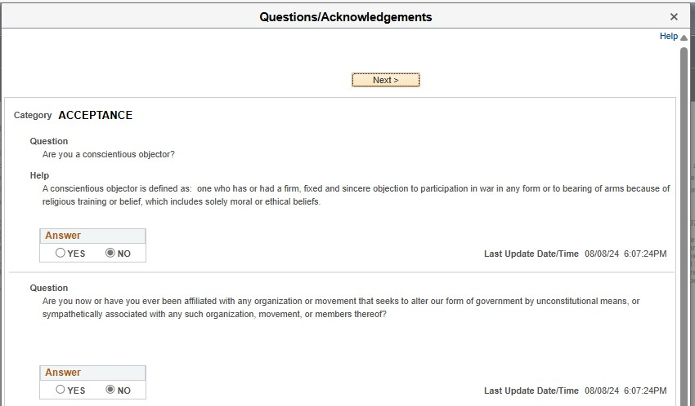
Importance of Honesty
It is crucial that you answer all questions truthfully. Providing false information or failing to disclose required details can have serious consequences, including disqualification from the AFROTC program.
Navigating Through the Sections
Use the Next and Previous buttons to navigate through the different categories of questions and acknowledgments.
Ensure that you complete and review each category thoroughly before proceeding.
Save and Close
After answering all questions and acknowledging the statements, click Save & Close to complete this section.
A checkmark will appear next to Critical Acknowledgements and Questions in your application checklist, indicating that this section is complete.

Slide 24
Step 12:
ROTC Releases and Forms
Access the "ROTC Releases and Forms" Section
  In the My ROTC Application checklist, click on ROTC Releases and Forms to begin this section.
List of ROTC Releases
  Drug Demand Reduction Release: This form acknowledges your understanding of AFROTC's Zero Tolerance policy on illicit drug use, including the possibility of random drug testing during the program.
  DD Form 2005-Health Care Records: This form outlines the purposes and policies for collecting medical and personal health information, which AFROTC may need during your participation.
  Mail Access Authorization Release: This authorizes detachment personnel to open official USAF mail on your behalf.
  Request for Release of Student Records: This allows AFROTC to access your student records as needed.
  AFROTC Form 28 - Pre-Participatory Sport Physical: This form is required if a DODMERB or MEPS physical has not yet been conducted. Important: Any standard sports physical can be used in place of AFROTC Form 28, but it is required to participate in the program. Complete this physical as soon as possible to avoid delays in your participation.

Slide 25
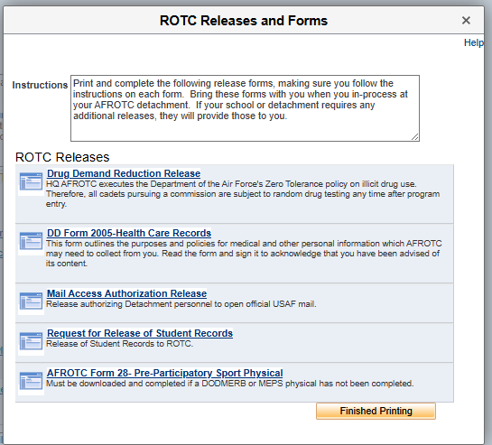
3.. Finished Printing
  Click the Finished Printing button to confirm that this step is complete.
  A checkmark will appear next to ROTC Releases and Forms in your application checklist, indicating that this section is complete.

Slide 26
Step 13:
Supporting Documents
Access the "Supporting Documents" Section
In the My ROTC Application checklist, click on Supporting Documents to begin this section.
Upload Required Documents
Based on your application answers, you will see a list of required documents that need to be uploaded. These may include forms such as:
  Drug Demand Reduction Release
  DD Form 214 - Certificate of Release/Discharge from Active Duty
  DD Form 2005 - Privacy Act Statement (Health Care Records)
  Mail Access Authorization Release
  Release of Student Records
To upload a document , click Add Attachment next to the corresponding form. Select the file from your computer and upload it. (Note: Do NOT upload the Drug Testing Memorandum unless you are 19 or older. If you are under the age of 19 your parents will need to sign this after you have returned your application documents to the AFROTC NCO).
Review and Verify Document Status
Once uploaded, your documents will be listed with a status indicator (e.g., "Pending," "Approved").
Ensure that all required documents are uploaded and that their statuses are updated as "Approved" by the detachment staff.
Additional Documents Section
Purpose: Use this section to upload any additional documents requested by the detachment staff or any documents you feel the detachment should review.
Uploading Additional Documents:
  Click Add Add’l Document to upload any extra documents.
  Provide a brief description for each additional document you upload.
File Status: Monitor the status of any additional documents you upload. Only documents in the "Pending" status can be deleted if needed.
Save and Close
After uploading all required and additional documents, click Save & Close to complete this section.
A checkmark will appear next to Supporting Documents in your application checklist, indicating that this section is complete.

Slide 27
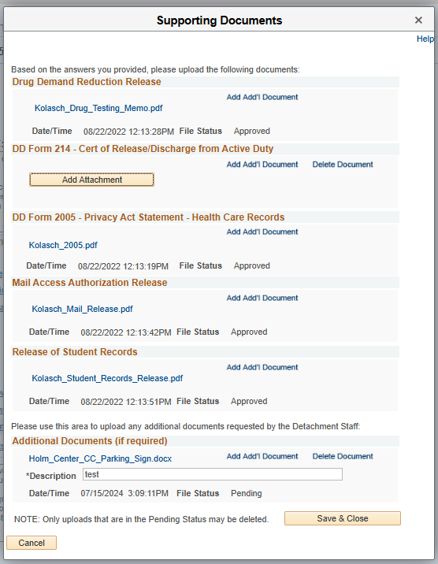
Step 14:
Civil Involvements
Access the "Civil Involvements" Section
In the My ROTC Application checklist, click on Civil Involvements to begin this section.
Understanding Civil Involvements
Carefully read the instructions provided at the top of the section. The Detachment Commander must know if you have ever been arrested, convicted, or involved with law enforcement or school/military authorities. This includes all incidents, regardless of how minor, such as traffic violations.
Important Note: All involvements—whether civil, school, or military—must be fully disclosed. Additionally, you must upload all relevant documents (e.g., citations, court records) to ensure your application is complete and accurate.
Note: Failing to report an involvement or providing false information can lead to disqualification from the AFROTC program.

Slide 28
Report an Involvement
If you have any civil, school, or military involvements to report, click the Add an Involvement button.
Provide the following information for each involvement:
  Date of Involvement: Enter the date the incident occurred.
  Involvement Type: Select whether the involvement is Civil, School, or
Military.
  Brief Summary of the Incident: Provide a concise summary of the incident (120 characters or less).
  Detained, Confined, Probation?: Indicate whether you were detained, confined, or placed on probation.
  Drugs or Alcohol Cited?: Indicate whether drugs or alcohol were involved in the incident.
  Supporting Documents: Upload any required documents, such as a copy of a ticket, citation, or court record.
Review Involvement History
Your reported involvements will be listed under Involvement History. Each involvement will show its status (e.g., "Excused") and a summary of the details.
If you need to add additional details or documents, you can do so by selecting the involvement and clicking Add Attachment.
Reporting Requirements
You must report any civil involvements to the Detachment Commander within 72 hours of their occurrence, including during periods away from campus (e.g., summer breaks or holidays).
Concealing or failing to report any involvement can result in serious consequences, including dismissal from the AFROTC program.
Save and Close
After reporting and reviewing all involvements, click Save & Close to complete this section.
A checkmark will appear next to Civil Involvements in your application checklist, indicating that this section is complete.

Slide 29
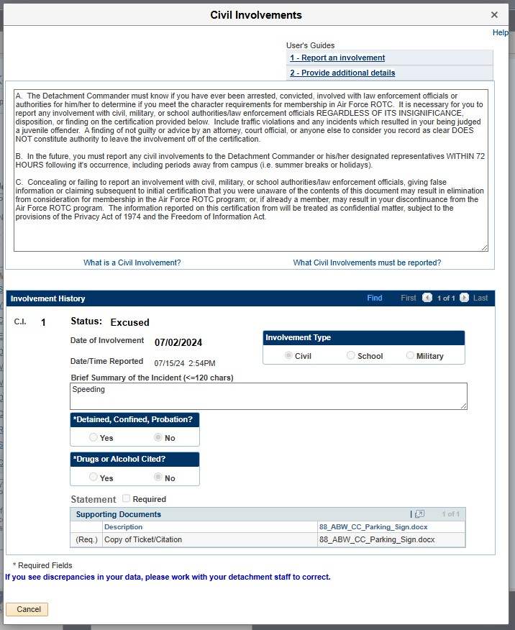
Step 15:
Review and Submit
Final Review of Application Checklist
Before submitting, review your My Application To Do List to ensure all sections are complete:
  Select Schools
  Youth Experience
  Contact Information
  Emergency Contact Info
  Demographics
  Military

Slide 30
Medical
Dependents
Questions/Acknowledgements
Releases & Forms
Supporting Documents
Civil Involvements
Each section should have a checkmark indicating it is complete.
Important Notes
Supporting Documents: Even though there is no checkbox for this section, it
must be completed. Ensure that all required documents have been uploaded.
Civil Involvements: If you have any civil involvements to report, ensure they are fully disclosed and reviewed. You can return to this section to add any new involvements if applicable.
Submit Your Application
Once you have confirmed that all sections are complete and reviewed, click the
Submit button at the bottom of the application screen.
Confirmation and Important Reminders
After submitting, you will see a confirmation message indicating that your application will be reviewed by an AFROTC staff member. You will be contacted if there are any issues or questions.
Important Reminders:
  Keep your contact information current so the detachment staff can reach you.
  Report any future adverse interactions with civil, military, or school authorities.
  Report any changes regarding drugs or alcohol.
  Report any changes to your citizenship status

Slide 31
  Ongoing Updates
You may continue to update your application as necessary even after submission
Any changes that occur after submission, especially those highlighted in the confirmation message, should be reported promptly.
Questions or Concerns
If you have any questions or concerns after submitting, you may contact one of the detachments you listed on your application. Contact information for detachments can be found on AFROTC.com.
Detachment staff can advise you on the remainder of the process and answer any questions you may have.

Slide 32
My Application
Kollasch, Andrew M.
Appl, Id: 104156
Hetp
Appl. Date: 08/18/2022
Join AFROTC: ®ves ONo
Please complete each section. A checkmark will appear in box once lhe section is complete.
NOTE:
SUpporting Documents DOES NOThave a checl<box. but MUST be completed.
CivillnvolVements DOES NOT have a checkbox. but MUST be reviewedfcomi,retedif you have involvement(s) lo repor1
• • � • ·- - -- ;,t;
Your application will be reviewed by an AFROTC staff member and you will be contacted if there are any issues or questions.
You may continue to update your application as necessary.
-Please keep contact information current so we can reach you.
-Any future adverse interactions with civil, military or school authorities should be reported.
-Any changes regarding drugs and alcohol should be reported.
-Any changes to citizenship status should be reported. (0,0)
I I
OK
--
��ndents
Questions/Acknowledgements Releases & Forms
.§!!P.QOrting Documents
Civil Involvements
Upload documents as needed
Youhave reported 1 civilinvolvements. Continue to re-porl involvements should they occur
Your application willbe reviewed by the detachments you selected Detachment staffshould contact you in the near future Please chedc your spam/junk folderregularly for any AFROTC co1Tespondence.
If youhave any questions or concerns, you may contact one of the detachments youlisted on your application (Detachment contact information can be found onAFROTC.corn) Detachment staffcan advise yoo on the remainder of the process and answer any questions yoo may have
SUBMIT

